Slide 1
PerFectIT
Midway Design Review
October 20th, 2017

Slide 2
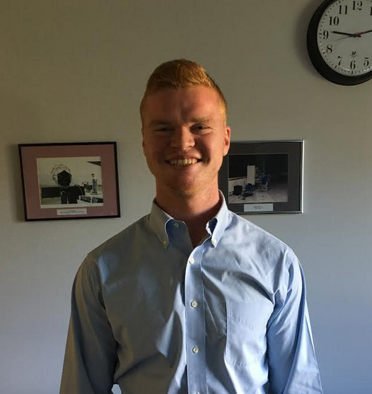
Introducing team members
Sai Yarram
Nick Raymond
Andrew Sjogren
Maxwell Gerhardson

Slide 3
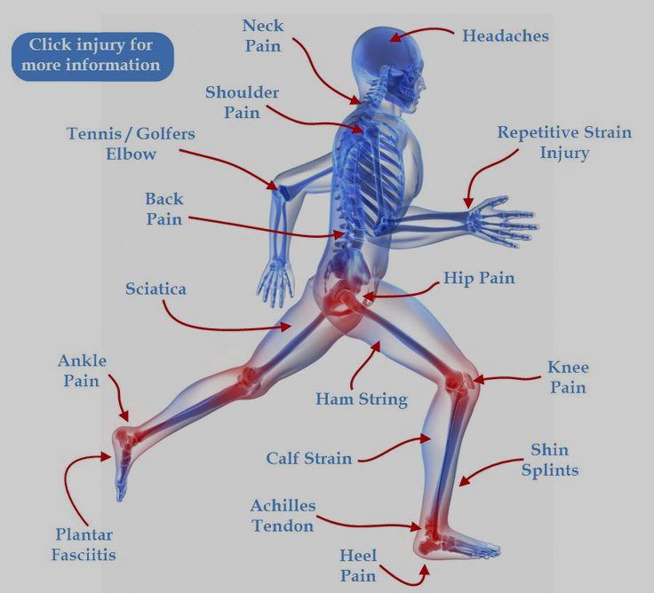
Injury prevention while exercising
Causes of Sports Injuries
Repetitive actions with poor form
Overtraining
Misuse of Exercise machines
Overlooking warm-up exercises
Current Prevention Methods
Personal trainers
Online tutorials
Expensive Group Classes

Slide 4
Injury Prevention
Current Preventive Measures
Personal Trainers: Very Expensive.
Online Tutorials: Can be misleading/hard to interpret
Group Classes: Not enough attention to individual/beginners
Self Learning: Can easily injure one’s self
Poor technology: SquatMe!
Injury may not occur at one instance, rather over a prolonged period of time due to incorrect practice (form, weight, etc.)

Slide 5
How significant is the problem?
From 1990-2007, it was reported that nearly one million americans found themselves in the emergency room with weight training injuries
Annual injuries increased more than 48% during that period
More than 90% of injuries occurred during the use of free weights (deadlifts, squats, curls, presses, etc.)
In 2015, weight training injuries approached nearly 110,000

Slide 6
Requirements Analysis: Specifications
Real-time monitoring and analysis of a person’s form while squatting
Use EMG to monitor the force attributed by each leg during the exercise
Measure the weight distribution and changes in the user’s center of gravity in real-time during resistance exercise
Foot pressure mapping
Inertial measuring unit (IMU)
Wearable technology
All hardware is built into a wearable device (knee brace, shoe insole, belt clip)
Wirelessly communicate data to mobile application for analyses
Low power consumption

Slide 7
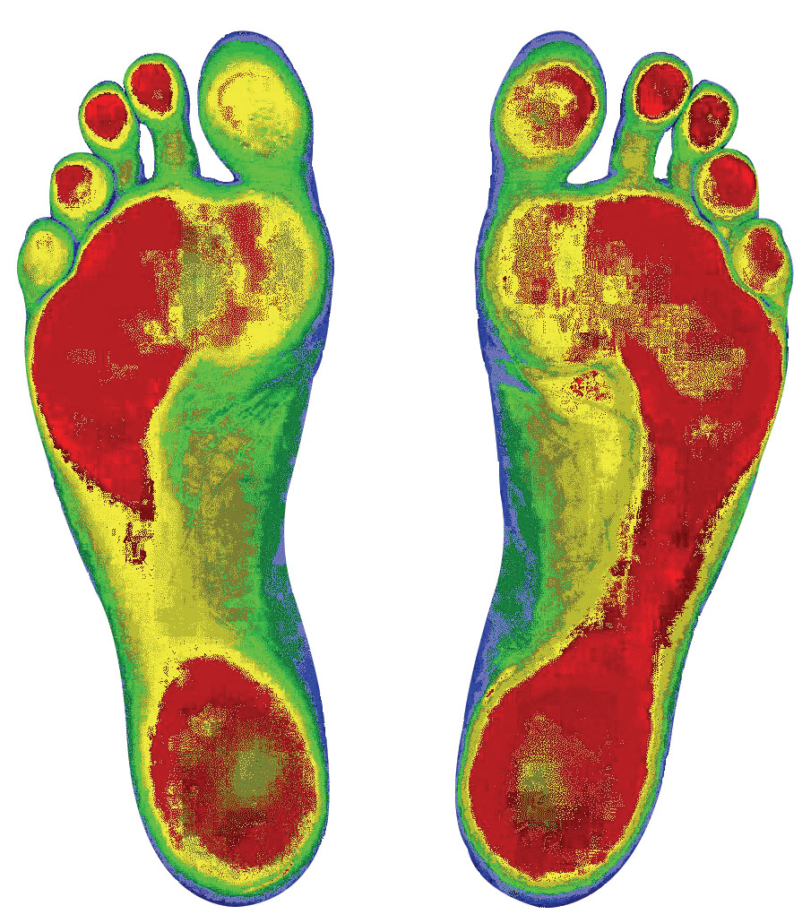
Requirements Analysis: Input and Output
Input
Muscle stress data
Foot pressure data
Inertial measurement unit data
Output
Quantitative analysis of error identification
Animation of weight distribution/center of gravity
Real-time user feedback

Slide 8
Design Alternatives (pressure sensitive insoles)
TrainRite (SDP 2016)
Utilizes pressure sensitive shoes to detect weight distribution across the foot
during weight lifting exercise
Wearable technology with mobile app
Analyses limited to imbalances in feet
Lacks detection of users center of gravity (at the hips)

Slide 9
Design Alternatives (visual monitoring)
Digital Fitness Trainer (SDP 2015)
Utilizes Microsoft Kinect to monitor form
Specially designed compression short monitors muscle fatigue
Limited to line of sight
Not a truly “wearable” technology
Personal Trainer
Expensive
Qualitative feedback

Slide 10
Our Solution: PerFectIT
A wearable monitoring system integrated with:
Pressure mapping insoles
Utilize pressure sensors to monitor a user’s balance during resistance exercise
EMG measuring knee braces
EMG sensors measure muscle strain at the quadriceps to ensure the user id driving through exercise with uniform force
Inertial Measuring Unit (IMU)
3-axis gyrometer and accelerometer measure imbalances in your center of gravity through your hips
Integrated into clip-on device (clip to weight-lifting belt or shorts)

Slide 11
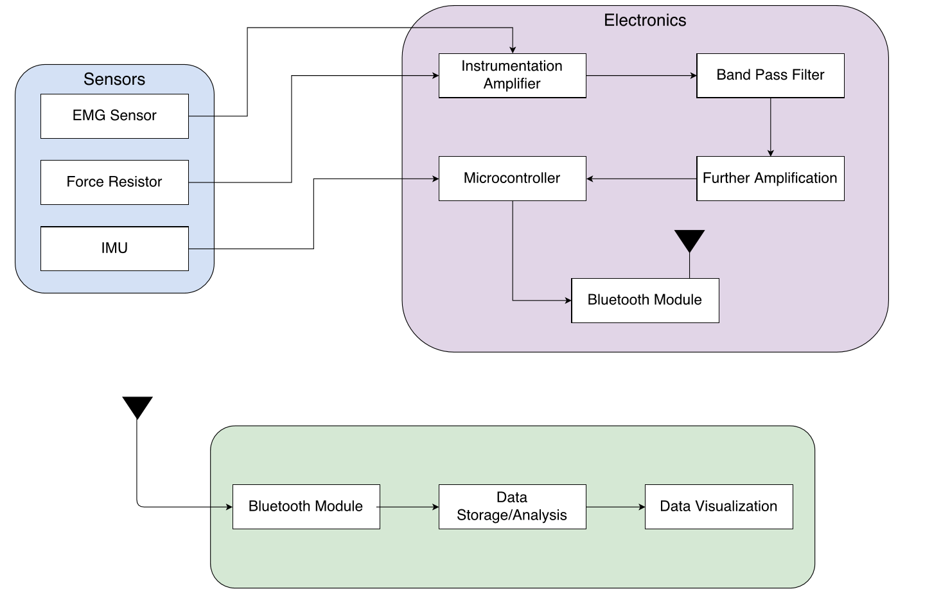

Slide 12
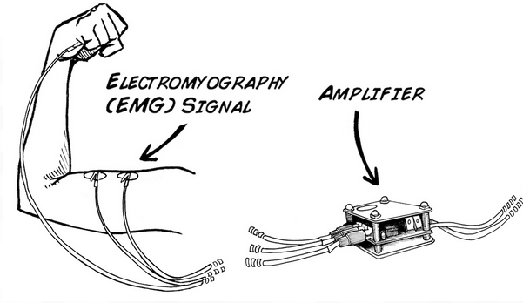
Instrumentation Amplifiers
EMG Signals are very small (5-200uV)
Skin has high impedance
Needs to be single supply
Analog Devices AD623
Single supply
High input impedance (2Gohm)
High gain (1-1000)
Used in low power medical instrumentation

Slide 13
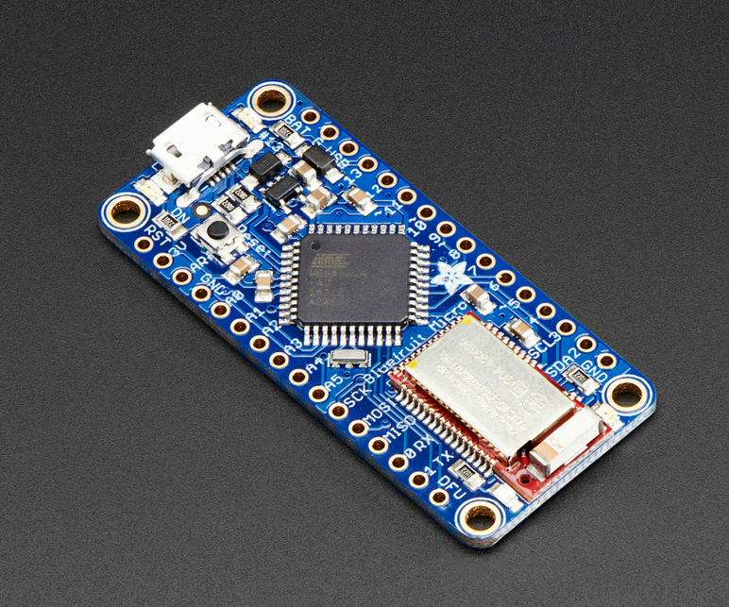
Microcontroller / ADC
Atmega8 microcontroller (low power, small size)
8-channel Analog Multiplexer
Up to 15 kSPS
Arduino Adafruit Bluefruit LE Micro
Atmega 32u4 (12-channel Analog Multiplexer)
Up to 15 kSPS
nRF51822 Bluetooth low energy

Slide 14
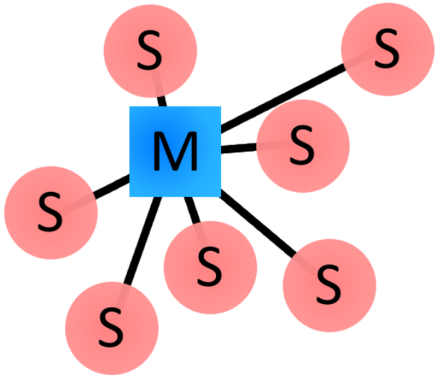
Bluetooth Module
Bluetooth Piconet
Establish a Bluetooth piconet in Android
Up to 7 slaves (we have 5)
Bluetooth 4.0 vs 3.0
Up to 300 feet in range
4.0 is used in wearables like Fitbit
4.0 has a very low power consumption
Which one operates more efficiently in the piconet? (TBD)

Slide 15
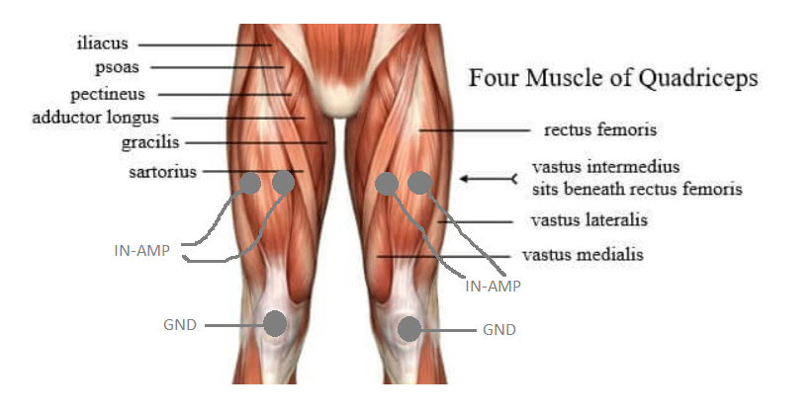
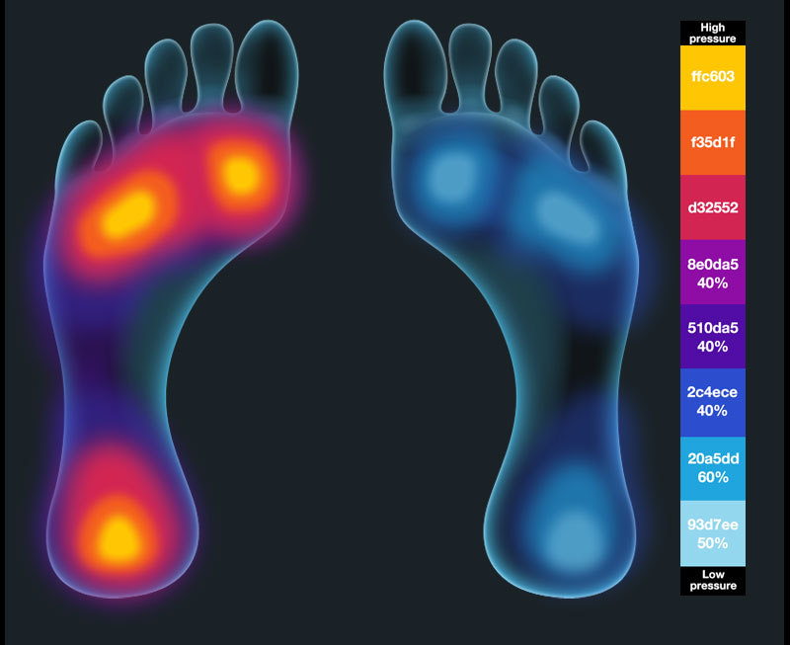
Sensor Objectives

Slide 16
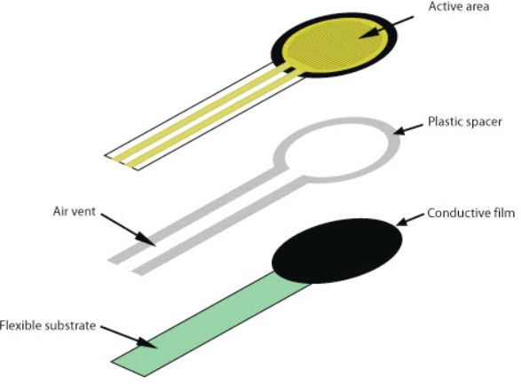
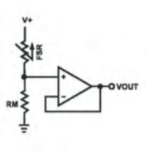
Sensors
Force Sensing Resistors (FSR)
Detect pressure, squeezing, and weight
Changes resistive value depending on pressure
More expensive than piezo sensors, but more reliable
Still low cost

Slide 17
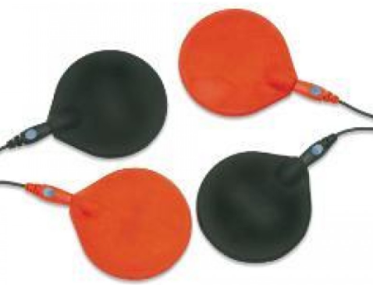
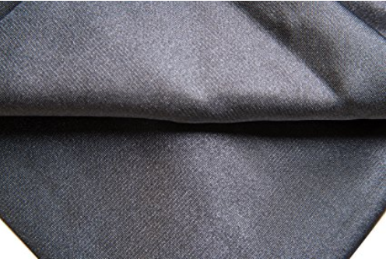
Sensors
Wearable Knee EMG Sensors
Silver Chloride Electrode
Standard for measuring biosignal from skin
Not very wearable
Try to use high conductive rubber pad / conductive textile
Very wearable
May be hard to implement
Will have to test each mechanism against each other (ideally textile)

Slide 18
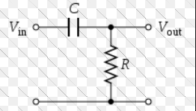
Filter Design
High Pass Filter
Due to high gain, the signal will have high levels of noise at high energy levels
After the signal is amplified, the resulting amplified signal will ensure that low frequency noise will be filtered out

Slide 19
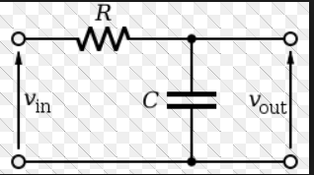
Filter Design
Low Pass Filter
After the signal has run through the HPF, the low pass filter will smooth out excessive noise
Used to smooth out noise from the resulting signal
Will be needed between any amplification component

Slide 20
Filter Design
First or Second Order Filters?
First Order Filters:
Less circuit components
Easier to implement / less costly
Second Order Filters:
Filters better than first order filters
More circuit components, but may be necessary

Slide 21
Software Design
Mobile Platform
Essential that the users have real time feedback analysis
Android or IOS
Data Transmission Protocol
TCP/UDP
Database Storage

Slide 22
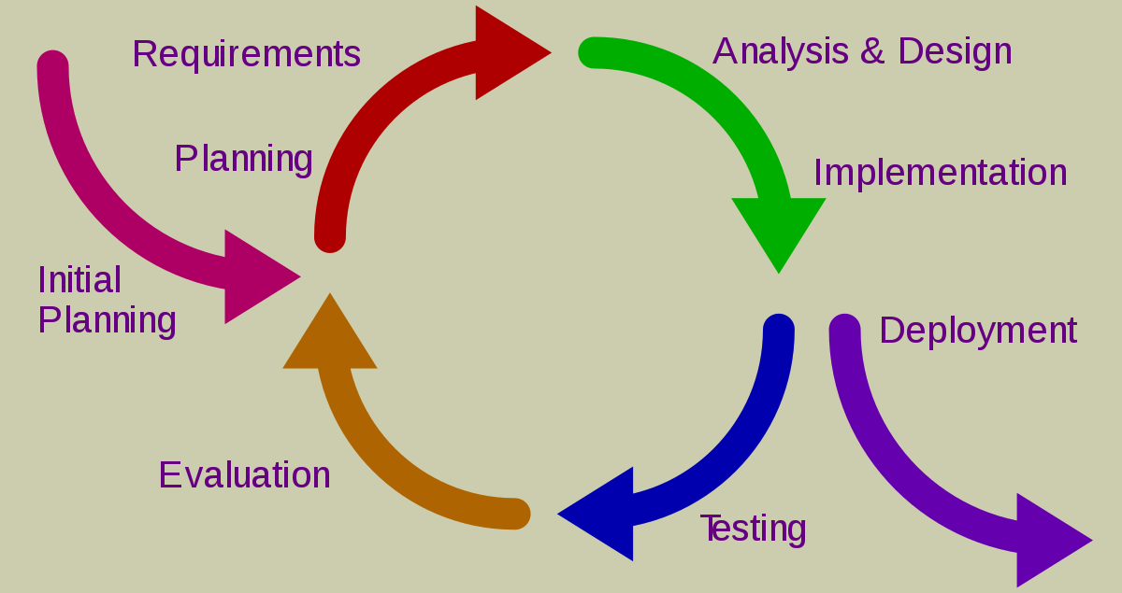
Software Design Specifications
Software Model Approach
Iterative Approach
Requirements
Flexible User Interface
Login/Password
PerFectIT Algorithm
Analysis of User Input
Important Metrics
Power, Reps, Acceleration, Weight Distribution
User Progress Tracking
Appealing visuals to show progress over time
Database Connection

Slide 23
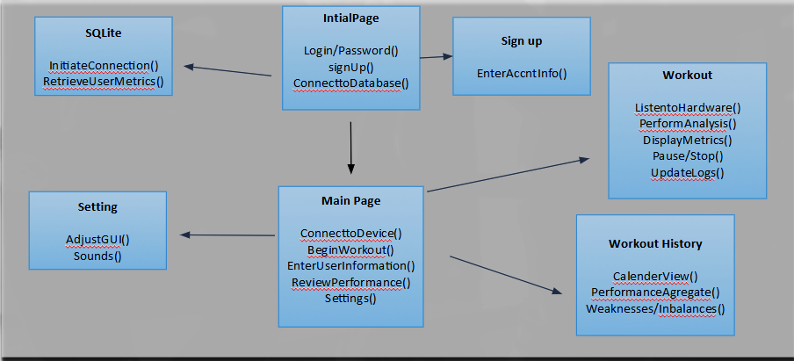
Low Level Design

Slide 24
Main Page
PerFectIT
Connect to Device
Review Performance
Edit Account
Begin Workout
Settings

Slide 25
PerFectIT
In Squat
Real Time Data
-Pressure metrics
-Graphical representation
Left Foot PSI:
8.4
Right Foot PSI:
7.6
Front/Back:
80%Back
Real Time Pressure Sensor Data

Slide 26
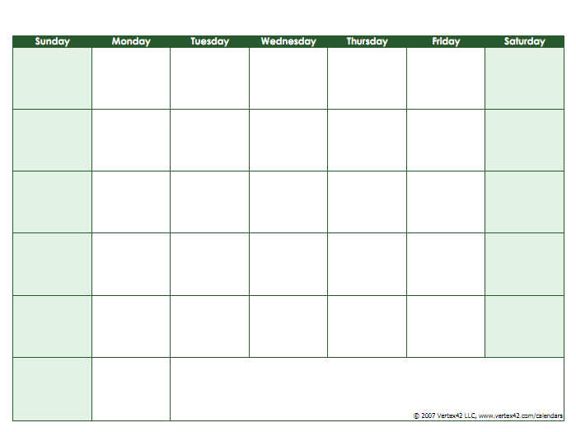
Workout History
-Workout Tracking Calendar
-Data Aggregates
PerFectIT
Track Progress

Slide 27
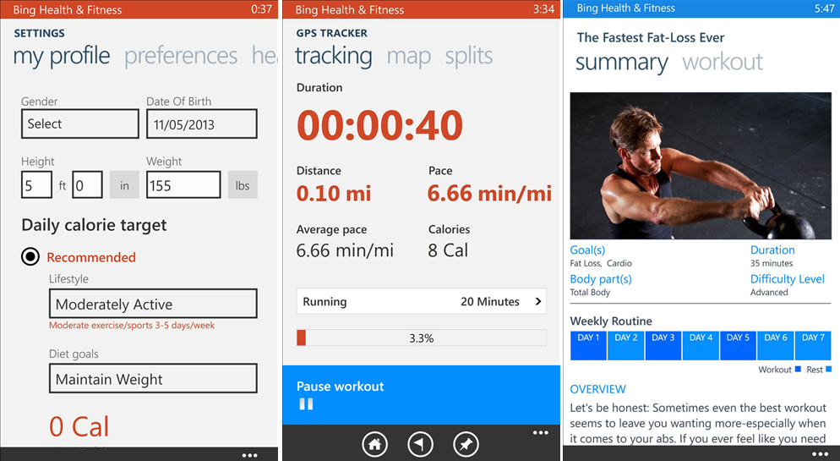
Personal Account

Slide 28
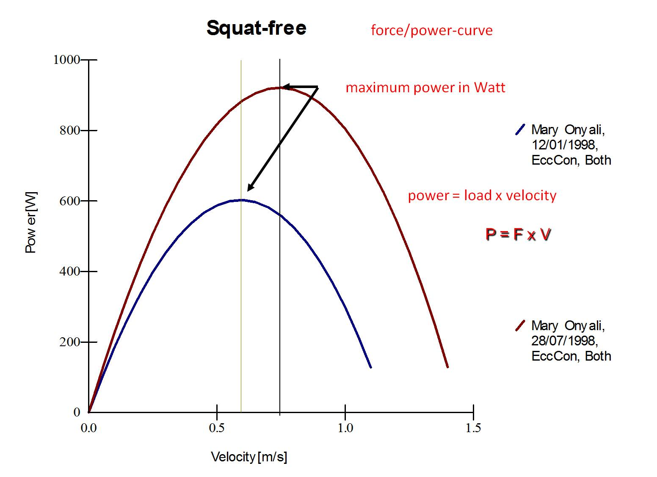
MDR Deliverables
Working foot sensors
Show expected readings on oscilloscope
Breadboard to be printed to the PCB
Decision between silver electrodes and textile cloth
Skeleton of Mobile User Interface
Initial Page
Login/Signup
Main Page

Slide 29
Individual Responsibilities
Software Team
Sai Yarram
Design Algorithm for user feedback
Server Implementation to store/retrieve user data
User Interface
Nick Raymond
User Interface/GUI (Show real live output)
User progress tracking over the course of weeks/months
Design Algorithm
Hardware Team
Andrew Sjogren
Selection of EMG sensors
Design and implementation of filters
Low Pass / Band Pass Filters
Maxwell Gerhardson
Design and implementation of instrumentation amplifiers
Design and implementation of IMU
Select the Bluetooth modules for setting up piconet

Slide 30
Time Table
Name | 10/27 | 11/17
Andrew | Select / Order Sensors and Filters | Complete Filter Design
Max | Select amp, gyro, accelerometer, and
Nick | Begin Work with Algorithms | Create Skeleton of app
Sai |  | Secure connection between application and auxiliary sensors

Slide 31
Thank You!

